Slide 1
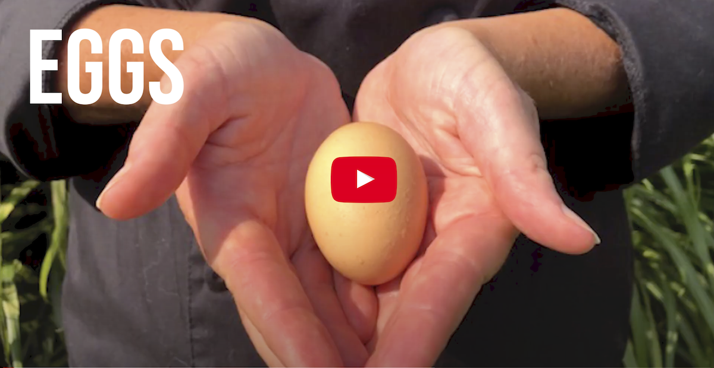
When is an egg not just an egg?
To celebrate World Food Day on 16 October, the UN has named eggs as one of its two star ingredients and developed a new film to promote the power of eggs.
This offers a unique opportunity for the egg industry to promote the egg, fully endorsed by the United Nations. Please share the below social media messages on World Food Day alongside the video to promote the valuable role our industry plays in feeding the world.
Watch the video and share on social media now
Did you know that eggs can change the world? They can… ⛽️ fuel nations ♥️ bring families together 💫 and be a culture’s star ingredient Eggs are good food – and good food is everything ⭐ https://bit.ly/3mR0g4V #WorldFoodDay #EggsForAll
Egg production transforms the lives of individuals, families, communities and entire populations around the world 🥚🌏❤️ Watch this United Nations video to find out how! https://bit.ly/3mR0g4V #WorldFoodDay #GoodFood4All #EggsForAll

Slide 2
🌏 This #WorldFoodDay2021, let’s talk about eggs! 🥚 They nourish children, fuel progress and can help secure the whole world’s future. Eggs are good food, and good food is everything. https://bit.ly/3mR0g4V #WorldFoodDay #GoodFood4All #EggsForAll
An egg 🥚 may be small – but it can be the whole world’s future. Watch this egg-cellent video from @FoodSystems to find out how… https://bit.ly/3mR0g4V #WorldFoodDay #GoodFood4All #EggsForAll
This 👉🥚 isn’t just an egg. It could bring a family together ❤️, keep a child in school 🎒📚, or fuel a brighter future 🌱 Eggs are good food – and good food is everything. https://bit.ly/3mR0g4V #WorldFoodDay #GoodFood4All #EggsForAll
Eggs are an everyday ingredient with an extraordinary power. They are accessible to people worldwide, they’re nutritious and they’re full of potential – bringing people together and fuelling our futures. Enjoy one of the world’s ⭐ingredients! https://bit.ly/3mR0g4V #WorldFoodDay #GoodFood4All #EggsForAll
The global egg sector helps create resilient and sustainable food systems, providing high-quality nutrition for all 🥚🌏❤️ Enjoy one of the world’s ⭐ingredients this #WorldFoodDay https://bit.ly/3mR0g4V #GoodFood4All #EggsForAll

